Slide 1
Getting started with cs-studio:

Slide 2
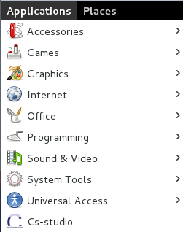
Running CS-Studio
Running cs-studio from applications menu
Applications → Cs-studio
Running cs-studio from command line
train@training:~/cs-studio$ ./cs-studio-with-pref
Notes:
NSLS2

Slide 3
Running CS-Studio
You can also install cs-studio yourself by downloading and unzipping the appropriate .zip file from
http://controlsystemstudio.org/download.html
~$: ./cs-studio
There are multiple versions of the cs-studio product. Customized for different sites and use cases
Notes:
NSLS2

Slide 4
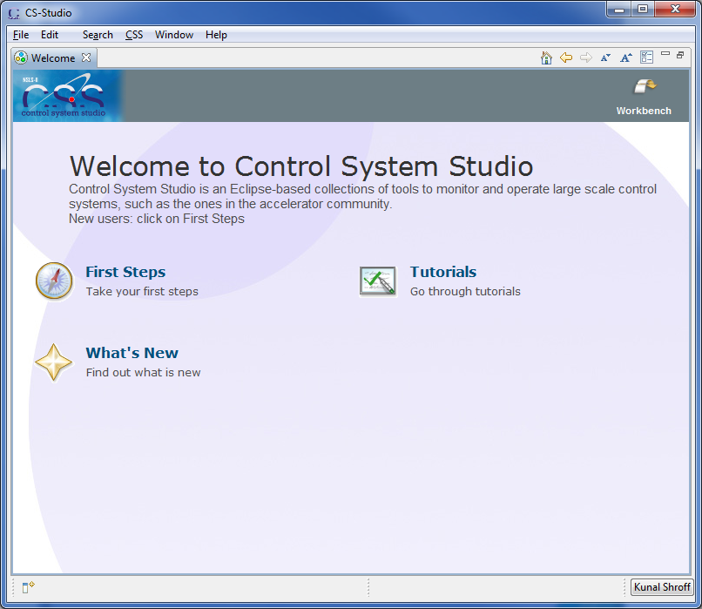
Welcome
First Steps
Tutorials
What’s New
Help → Welcome

Slide 5
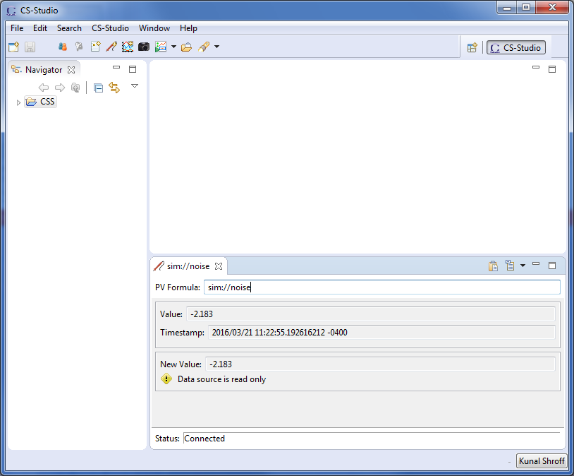
Workbench
It represents your working environment.
Window
Menu bar
Toolbar
Perspective bar
Views

Slide 6
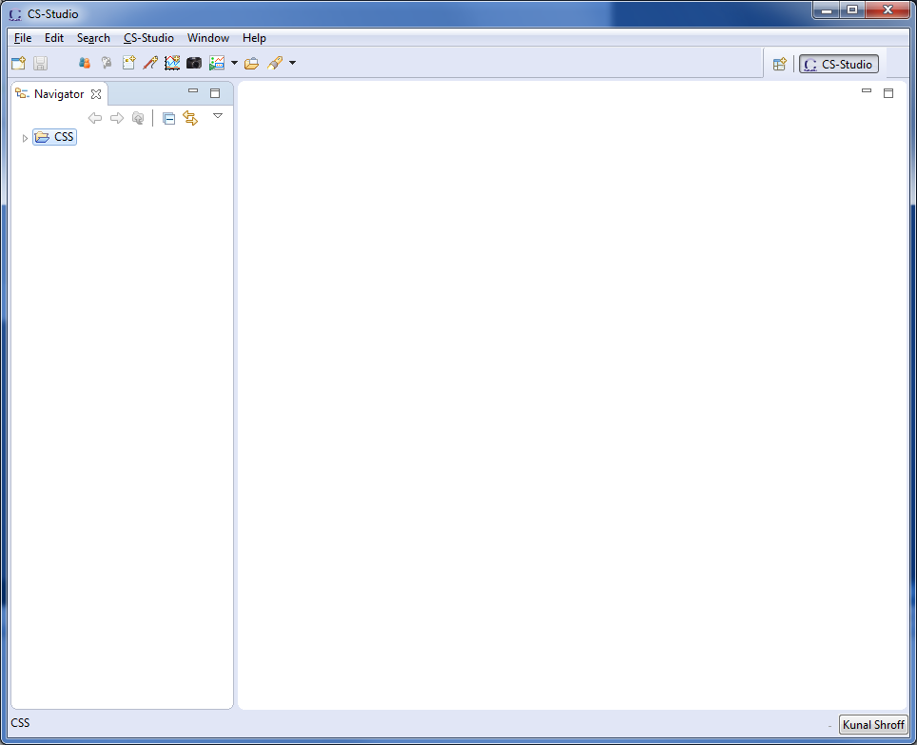
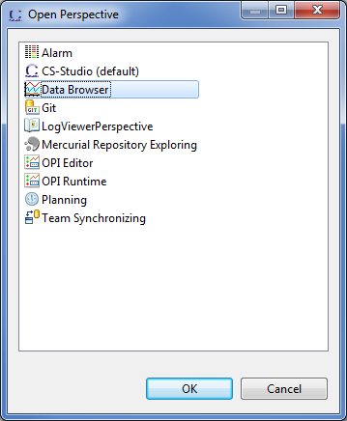
Perspectives
A set of views and editors best suited for using a particular application.
Example:
Window → Open Perspective → Other Select Data Browser
Notes:
Perspectives – views - editors

Slide 7
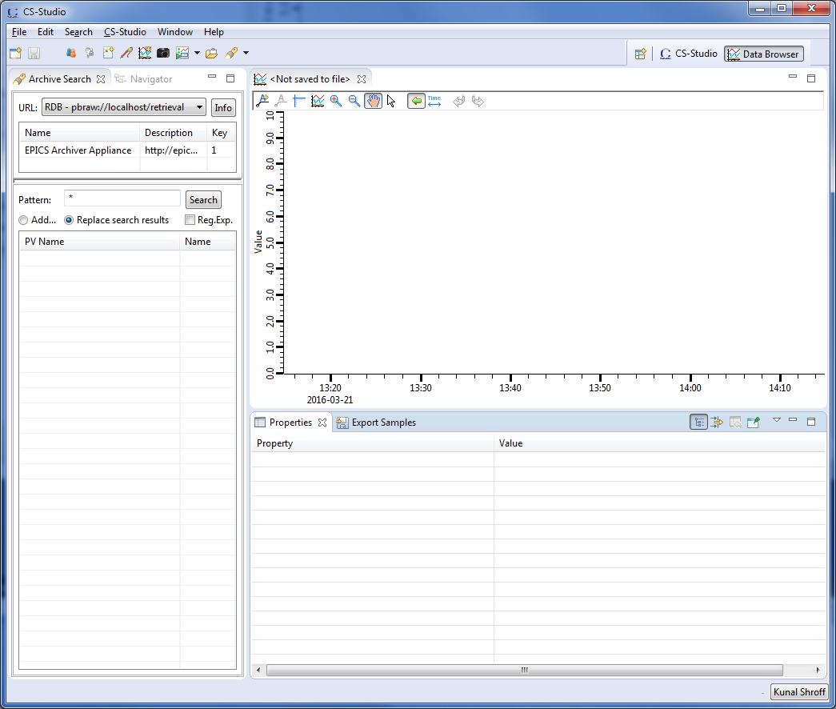
Databrowser Perspective
Views Archive View Property View
Editor Databrowser Plot
Perspective bar Databrowser perspective selected
Notes:
Perspectives – views - editors

Slide 8
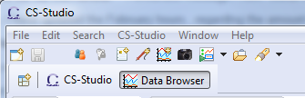
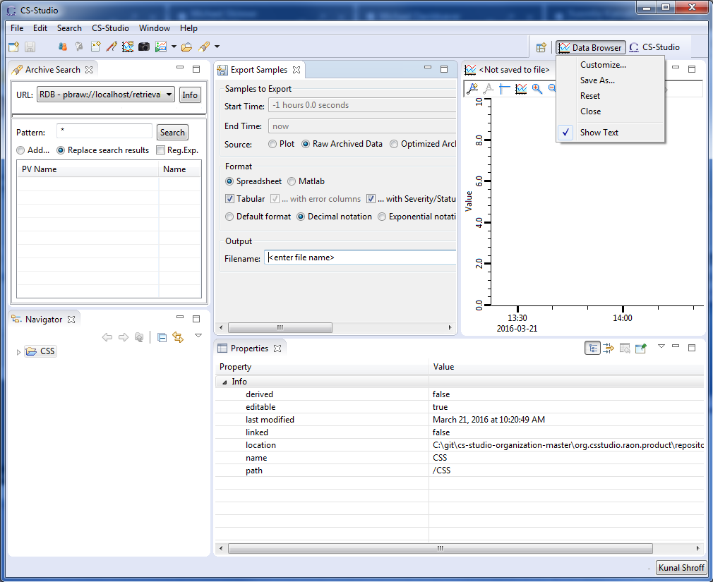
Perspective bar
Open new perspectives
Switching between perspectives
Resetting the perspective
Save your perfect perspective
Notes:
Perspective toolbar and resetting

Slide 9
My perspective
Moving views
Click on view title and drag to desired destination
Minimize & Maximize views
Double click on view title
Close views
View menu and toolbar
Notes:
moving views, minimizing maximizing

Slide 10
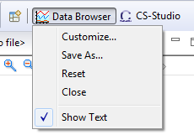
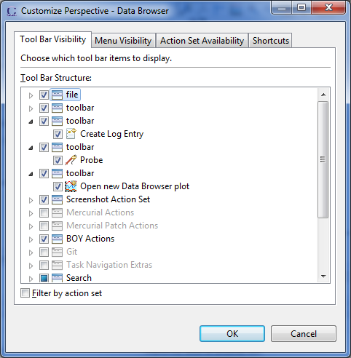
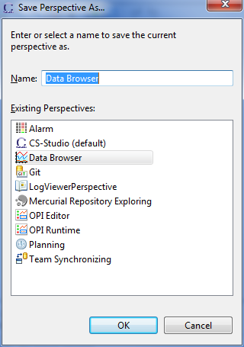
My perspective
Customize perspective
Toolbars
Menus
Actions
shortcuts
Save As
Save the changes to a new named perspective
Reset
Reset the perspective to the default arrangement
Notes:
moving views, minimizing maximizing

Slide 11
Windows
A workbench can be made up of multiple windows
Dedicated window for different operations i.e. Motor & Camera control screens - Alarm – Logbook
Each window can be set to a different perspective
New window
Window → New Window
Views & Editors can be moved across multiple windows
Notes:
Windows – creating a new window, moving views to windows, closing windows

Slide 12
Workbench State
Picking up where you left off
CS-Studio Restores
Windows
Perspectives
Saved Files in appropriate editors
Views restored to last state
Notes:
Cs-studio saves state

Slide 13
More information
Help → Help Contents

Slide 14
Questions

